Slide 1
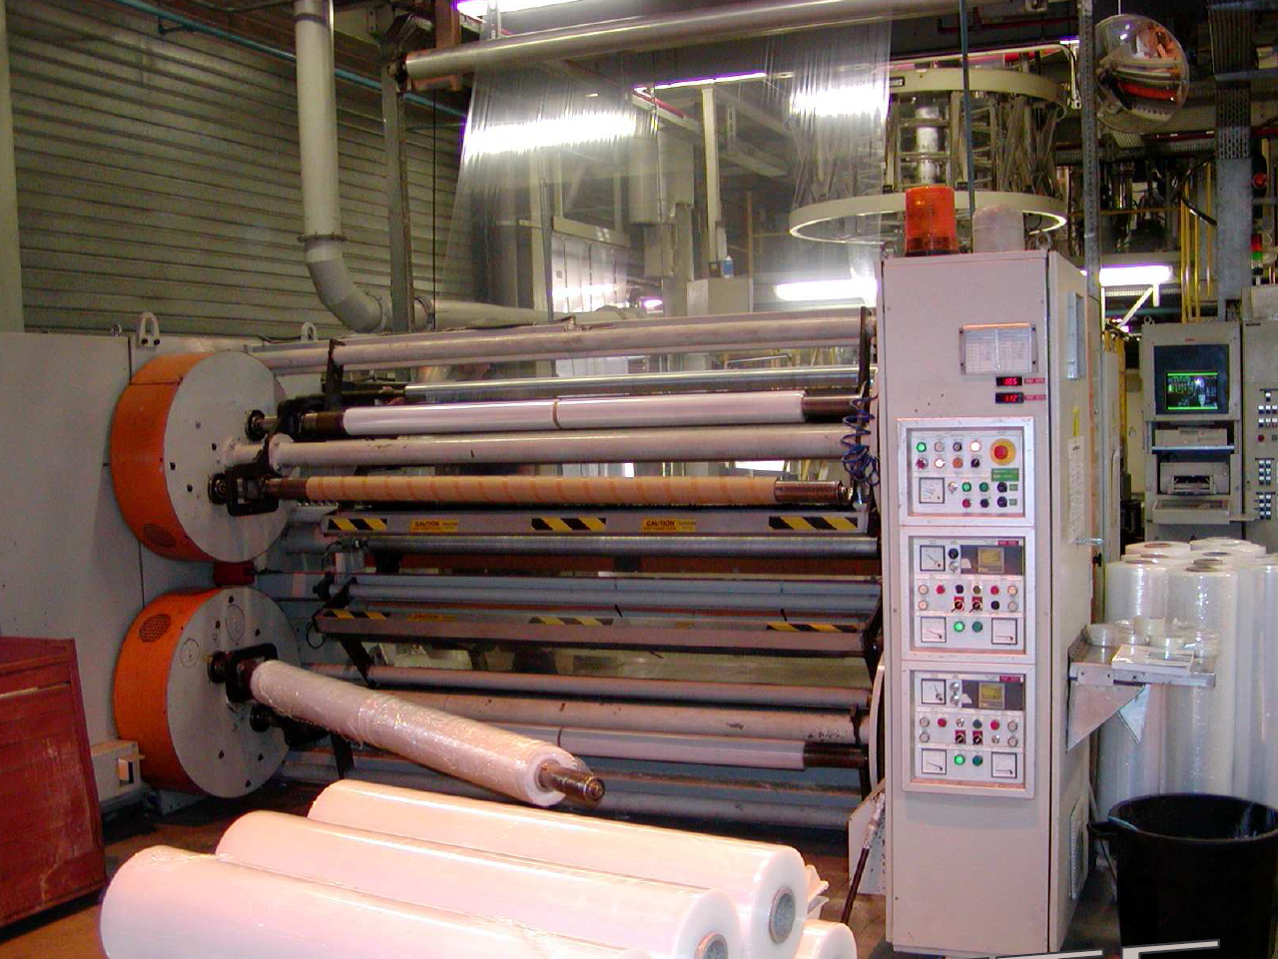
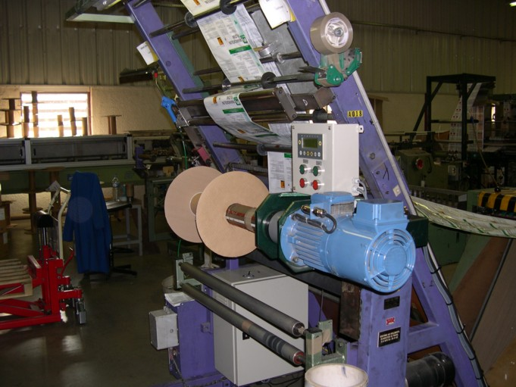
Variable Speed Drives application note
Winder / Unwinder

Slide 2
Winder/Unwinder Application
I. Introduction
II. Types of Winders/Unwinders
III. Tension control
IV. Basic functions
V. The controller inside offer
VI. Appendix

Slide 3
Introduction
Winder/Unwinder systems are very frequently used in the industry
The allow to wind or unwind tapes or wires of all kind of material (paper, metals, fiber, plastic film …).
Basically, you can find them at the beginning (feeding) or at the end (storage) of a transformation process.
The system must ensure, for example, steady winding with regulated tension whatever the line speed and the bobbin diameter.
The principals are various, but common functions can be isolated : tension regulation of the material or linear line speed, start/stop control ...
The actual speed drives are effective enough to take into account theses functions.
Notes:
In many industrial sectors, such as the paper, plastics, textile or sheet metal industries, materials in continuous, flexible strip form (web) must be unwound or rewound before and after processing. To prevent the material from tearing, it must be wound without wrinkles or creases and the tension must be constant.
This constant tension central winder has an unwinder with two drives: one for the take-up roller and one for the pull-off roller. The pull-off roller usually operates with speed control, in which case the material is unwound at a constant path speed. The winder determines the tensile force, while the speed signal from the pull-off roller functions as a control signal. In many applications, a drive is not required for the pull-off roller. It can be replaced by a master encoder that delivers the master signal for the winder.

Slide 4
Winder/Unwinder Applications
I. Introduction
II. Types of Winders/Unwinders
III. Tension control
IV. Basic functions
V. The controller inside offer
VI. Appendix

Slide 5
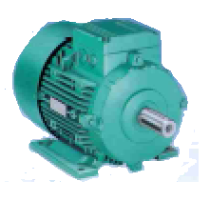
Types of Winders/Unwinders
Surface winding system
Winder
Line
Regulated tension
Nip rolls

Slide 6
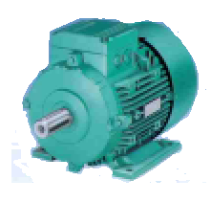
Types of Winders/Unwinders
Central winding system
Winder
Line
Regulated Tension
Nip
rolls

Slide 7
Types of Winders/Unwinders
Roll system
Unwinder
Rider
roll
Tension
Winder
rear
roll
front
roll
Tension

Slide 8
Winder/Unwinder Applications
I. Introduction
II. Types of Winders/Unwinders
III. Tension control
IV. Basic functions
V. The controller inside offer
VI. Appendix

Slide 9
Tension control
In order to illustrate the basics, we take the case of a simple Winder/Unwinder with a central winding system.
We distinguish 4 types of basic functions:
  Feeding or releasing of the film --> line speed regulation.
  Winding --> tension control.
  Unwinding --> speed control or tension control
  Breakdown or stuck of the machine --> speed control + fast stop
In order to manage theses different cases, you must know or calculate the following parameters:
  Line speed
  Bobbin diameter
  Tape tension
  Bobbin inertia
  Mechanical losses ...

Slide 10
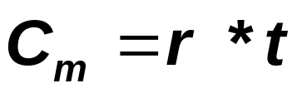
Tension control
Tension torque
constant tension
r
In steady state, ignoring the frictions, if the bobbin is pulled by its axis and directly linked to the motor then :
to obtain continuous Tension on a product :
the motor Torque must be proportional to the radius.
Cm : Motor torque (N.m)
r : radius (m)
t : tension (N)

Slide 11
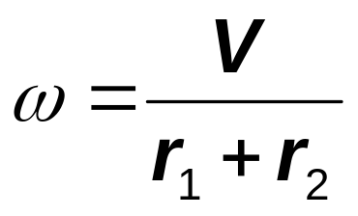
Tension control
Line speed
Constant line speed
ω₁
ω
In the same case
if the line Speed is contant :
the motor Speed is proportionally inverted to the radius.
r₁ start
r₂
V : line speed in m/s
ω : motor speed (rad/s)
r : radius (m)

Slide 12
Tension control
Relation torque/speed
For winding and unwinding the motor works with :
Continuous power,
Speed and Torque variable
P = continuous
Start of winding
or end of unwinding
Torque
Motor Speed
End of winding or
start of unwinding
Empty
reel
Bobbin Radius
Radius min
Radius max

Slide 13
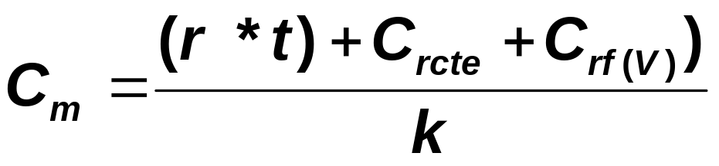
Tension control
Total resistant torque
Continuous tension
f
k
r
M
In order to estimate the motor torque in steady state you must also take into account the continuous and variables losses of the system linked to the frictions, various efficiency and eventually to a reducer.
Theses resistant parasite torques are generally measured or estimated by an empty test with different speeds.
η
Cm : Motor torque (N.m)
r : radius (m)
t : tension (N)
η : output
f : friction
k : reduction ratio

Slide 14
Tension control
Relation restistant torque /resulting speed
Motor torque
Start of winding
or end of unwinding
Tension torque
Motor speed
Constant losses
End of winding or
start of unwinding
Variable losses
Empty reel
Bobbin radius
Radius min
Radius max

Slide 15
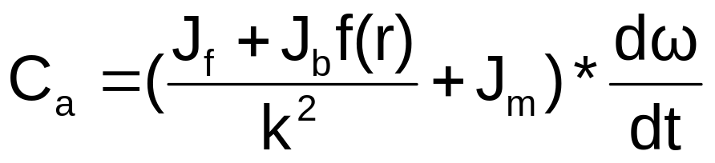
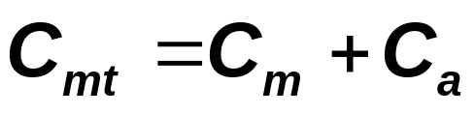
Tension control
Accelerating torque
traction constante
k
In transitory state (acceleration/deceleration) it is also suitable to adapte the torque relating to the inertias to drive.
Two types of inertias exist :
  - fix for the motor, the reducer, the empty reel
  - variable for the bobbin (related to the radius)
r
M
Jm
Jb
Jf
Cm : permanent motor torque (N.m)
Ca : Accelerating motor torque (N.m)
Cmt : Transitory motor torque (N.m)
r : radius (m)
Jmd : empty reel inertia (kg.m²)
Jb : bobbin inertia (Kg.m²)
Jm : motor inertia + reducer (Kg.m²)

Slide 16
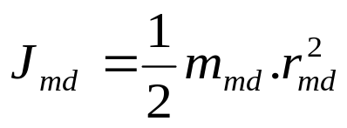
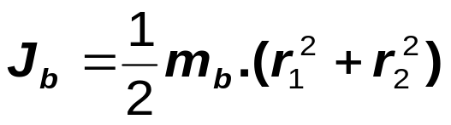

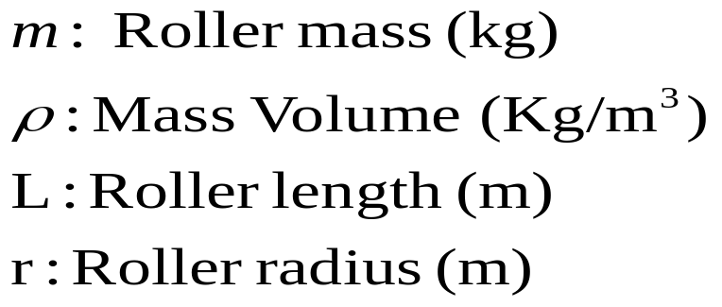
Tension control
Calculation of bobbin inertias
L
1/ empty reel inertia (fixe)
r
empty reel
2/ bobbin inertia (variable)
r₁Start
r₂Fin
Roller mass :

Slide 17
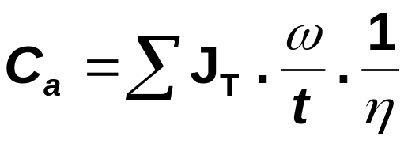
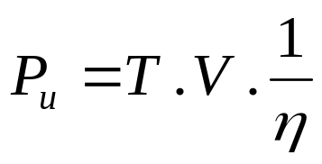

Tension control
Motor sizing
Accelerating torque for the motor
Useful power of the motor
Sizing, power of the motor
Ca : Motor Accelerating torque (N.m)
Jt : total inertia of the motor (kg.m²)
Jb : bobbin inertia (Kg.m²)
Jm : motor inertia + reducer (Kg.m²)
ω : motor speed (rad/s)
t : acceleration min (s)
V : line speed (m/s)
η : system effieciency
Cr2 : resistant torque at the end of winding (N.m)
ω1 : motor speed at the start of winding (rad/s)

Slide 18
Winder/Unwinder Applications
I. Introduction
II. Types of Winders/Unwinders
III. Tension control
IV. Basic functions
V. The controller inside offer
VI. Appendix

Slide 19
Basic functions
Basic functions of winder/unwinder with central drive.
Motor
Speed
Speed line
VSD
tension
Diameter
Tension
set point
Speed reference
Regulator
Tension profile
Torque reference
Calculation
bobbin radius
Inertia comp.
Motor speed
Frictions comp.
Notes:
The functions of the "Central Winder" application module are divided into three areas:
Calculation of the roller diameter
Calculation of the tensile force
Adjustable winding curve
Calculation of the tensile force
The tensile force must be adjusted very accurately for flawless operation of the winding machine. To achieve this, the following parameters must be taken into account:
Current winding diameter
Winding characteristics
Friction coefficients of the mechanical components
Calculation of the roller diameter
Many winding machines measure winding diameter to determine and set the correct winding speed. In this case, the diameter does not need to be measured.

Slide 20
Basic functions
Function radius determination
The radius is one of the key parameters to calculate the set points and corrections.
It can be calculated with the line speed (encoder or analogue sensor) and the angular speed of the bobbin (motor encoder)
Radius = V line / ω bobbin
or measured with a diameter sensor (ex analogue ultra-sonic 4-20mA).
V line
measurement
ω bobbin

Slide 21
Basic functions
Tension regulation : radius calculation
integrator
Line speed
Bobbin turns counter
reset
÷
integrator
Bobbin axis speed (motor)
scaling
Bobbin radius
Bobbin radius sensor

Slide 22
Basic functions
Function tension profile
trension
In reality the tension on the tape is rarely continuous. You might, for example, want a strong pulling at the beginning of the tape and less strong at the end.
This function allows to define the tension profile along the building of the bobbin. It modifies the tension set point according to the selected profile.
Following the material you can have different profiles.
The profiles are only necessary for the winding.
max
square
linear
constant
Hyperbolic
min
radius

Slide 23
Basic functions
Tension regulation : tension set point
Traction
Gains
profile
T1
T2
max
min
Rayon
Tension set point
Tension profile
Ramps
Radius
PI
Final tension set point
Filter
scaling
Tension feedback

Slide 24
Basic functions
Function Speed set point
In tension mode the bobbin follows as closely as possible the line speed with the necessary latitude to follow the tension profile (Torque set point)
In speed mode the regulation of the torque is no more active. The winder/unwinder follows the speed set point.
The line speed information is given by an external sensor (encoder, tachometer..) or by the supervisor.
V line
ω bobbin

Slide 25
Basic functions
Tension regulation : Speed set point
Tension or speed state
Drive Speed set point
Line speed
L
Scaling
Dead
band
Ramps
D
Bobbin radius
Acceleration
DS
?
Deceleration

Slide 26

Basic functions
Function inertia compensation
During acceleration and deceleration, if the inertia is not compensated, it results in strong tension pulling which may result in breaking or folding the tape.
This function calculates the constant and variable inertia and adapts the torque set point to maintain the tension profile.
The variable inertia varies as power 4 of the radius.
Transitory motor torque
Resulting
accelerating Torque
Bobbin accelerating Torque
empty reel accelerating torque
Resistant torque
radius

Slide 27
Basic functions
Tension regulation : inertia compensation
Tension set point
Σ
Limitation
bobbin
inertia
calculation
x radius
acceleration
Drive torque set point
Σ
Constant inertia calculation
deceleration

Slide 28
Basic functions
Function friction compensation (losses)
The frictions (losses) represent the torque which is not used for the tension neither the drive inertia.
We distinguish 2 types of losses :
  Continuous losses (statics)
  Variable losses linked to speed (dynamics)
Theses losses are generally determined by a « real life » test.
Static losses : no load torque for 10% of the speed
Dynamic losses : no load torque function of the speed
Following the systems, the dynamic losses can be proportional to speed or not.
Torque
Total losses
Variable losses
Constant losses
Line speed

Slide 29
Basic functions
Tension regulation : Frictions compensation
Tension set point
couple
T1
T2
max
Σ
Limitation
min
vitess
Dynamic losses
x speed
winder
Σ
torque set point
Static losses
unwinder

Slide 30
Basic functions
Tension regulation
Tension regulator
Tension set point
Σ
Σ
Inertia compensation
frictions
compensation
Torque set point
Speed drive
Speed loop
Torque loop
Speed set point
Σ
Σ
M
E

Slide 31
Winder/Unwinder Applications
I. Introduction
II. Types of Winders/Unwinders
III. Tension control
IV. Basic functions
V. The controller inside offer
VI. Appendix

Slide 32
Winder/Unwinder Applications
I. Introduction
II. Types of Winders/Unwinders
III. Tension control
IV. Basic functions
V. The controller inside offer
VI. Appendix

Slide 33

Module titre
Q
Q
uestions - Answers

Slide 34
Motion&Drive Domain
Thank you
Merci
For your attention

